Slide 1
CSE 219 Industrial Revolutions and Emerging Technologies
Bangladesh Digital University
Presented by
Md. Abdullah Al Mamun
Id: 2101020
Dept: IRE
Session: 21-22
Presented to
Md. Masud Rana
Lecturer
Dept: IRE

Slide 2
Presentation Topic:
IoT
Definition
Components
Application

Slide 3
IoT definition:
What is IoT?
The Internet of Things, or IoT, is a network of devices (like phones, cars, and home appliances) that connect and share data with each other over the internet.
It allows devices to “talk” to each other to make our lives easier—like a thermostat adjusting the temperature based on weather or a smartwatch tracking your health.
How Did IoT Start?
IoT began with early tech that allowed devices to be tagged and tracked, but it took off with the internet and smartphones.
Today, IoT is everywhere—from smart homes and wearable health devices to traffic systems in cities.

Slide 4
Core Components of IoT
Sensors and Actuators:
Types of sensors (e.g., temperature, motion) and actuators with examples.
Connectivity:
Overview of major connectivity options like Wi-Fi, 5G, and Bluetooth, with emphasis on their impact on IoT scalability.
Data Processing and Analytics:
The role of data in IoT, including edge computing and cloud analytics.
User Interface:
How users interact with IoT, from mobile apps to comprehensive dashboards.

Slide 5
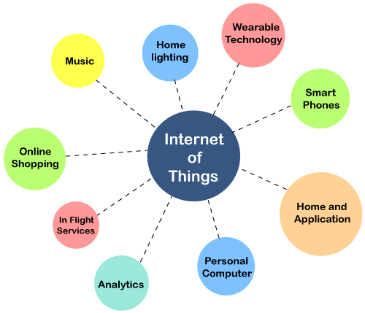
Applications of IoT

Slide 6
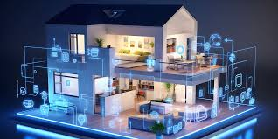
Smart Homes: Use cases in home automation, energy efficiency, and security, with specific examples

Slide 7
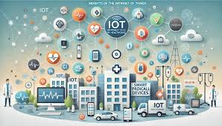
Healthcare: Key advancements in remote monitoring and wearables, with examples from companies or case studies.

Slide 8
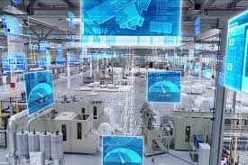
Industrial IoT (IIoT): How IIoT is transforming industries with predictive maintenance and optimization.

Slide 9
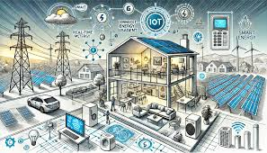
Smart Cities: Application of IoT in urban management, including traffic, pollution, and waste control

